Slide 1
Nanopore Plasmid Assembly
July 03, 2025
Qinghui Li

Slide 2
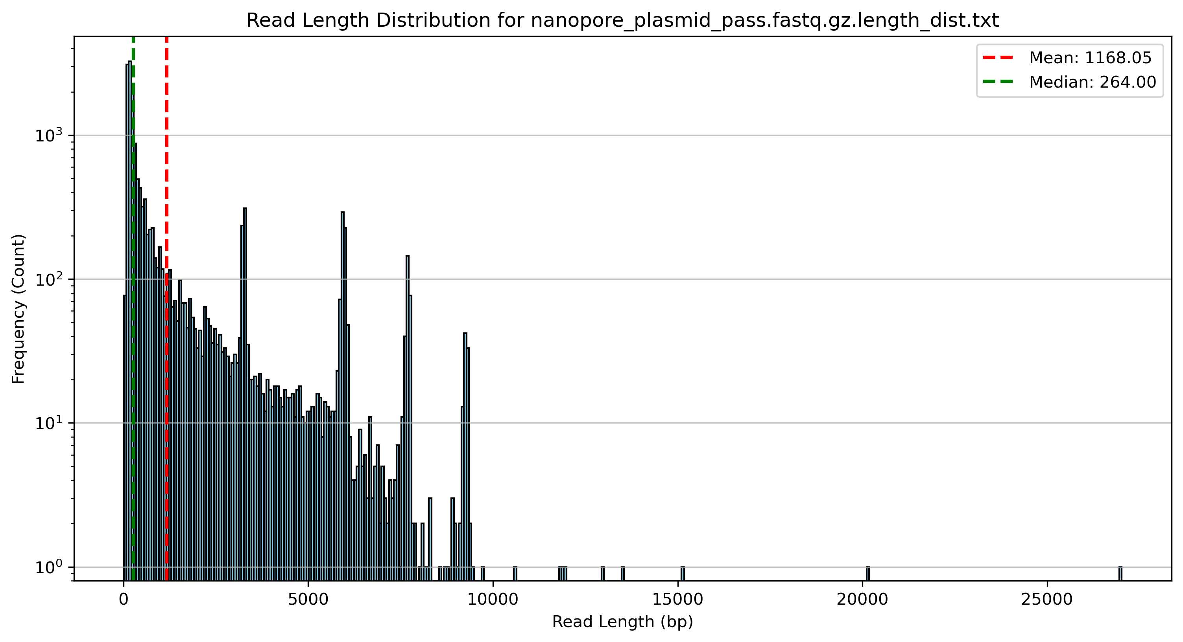

Slide 3
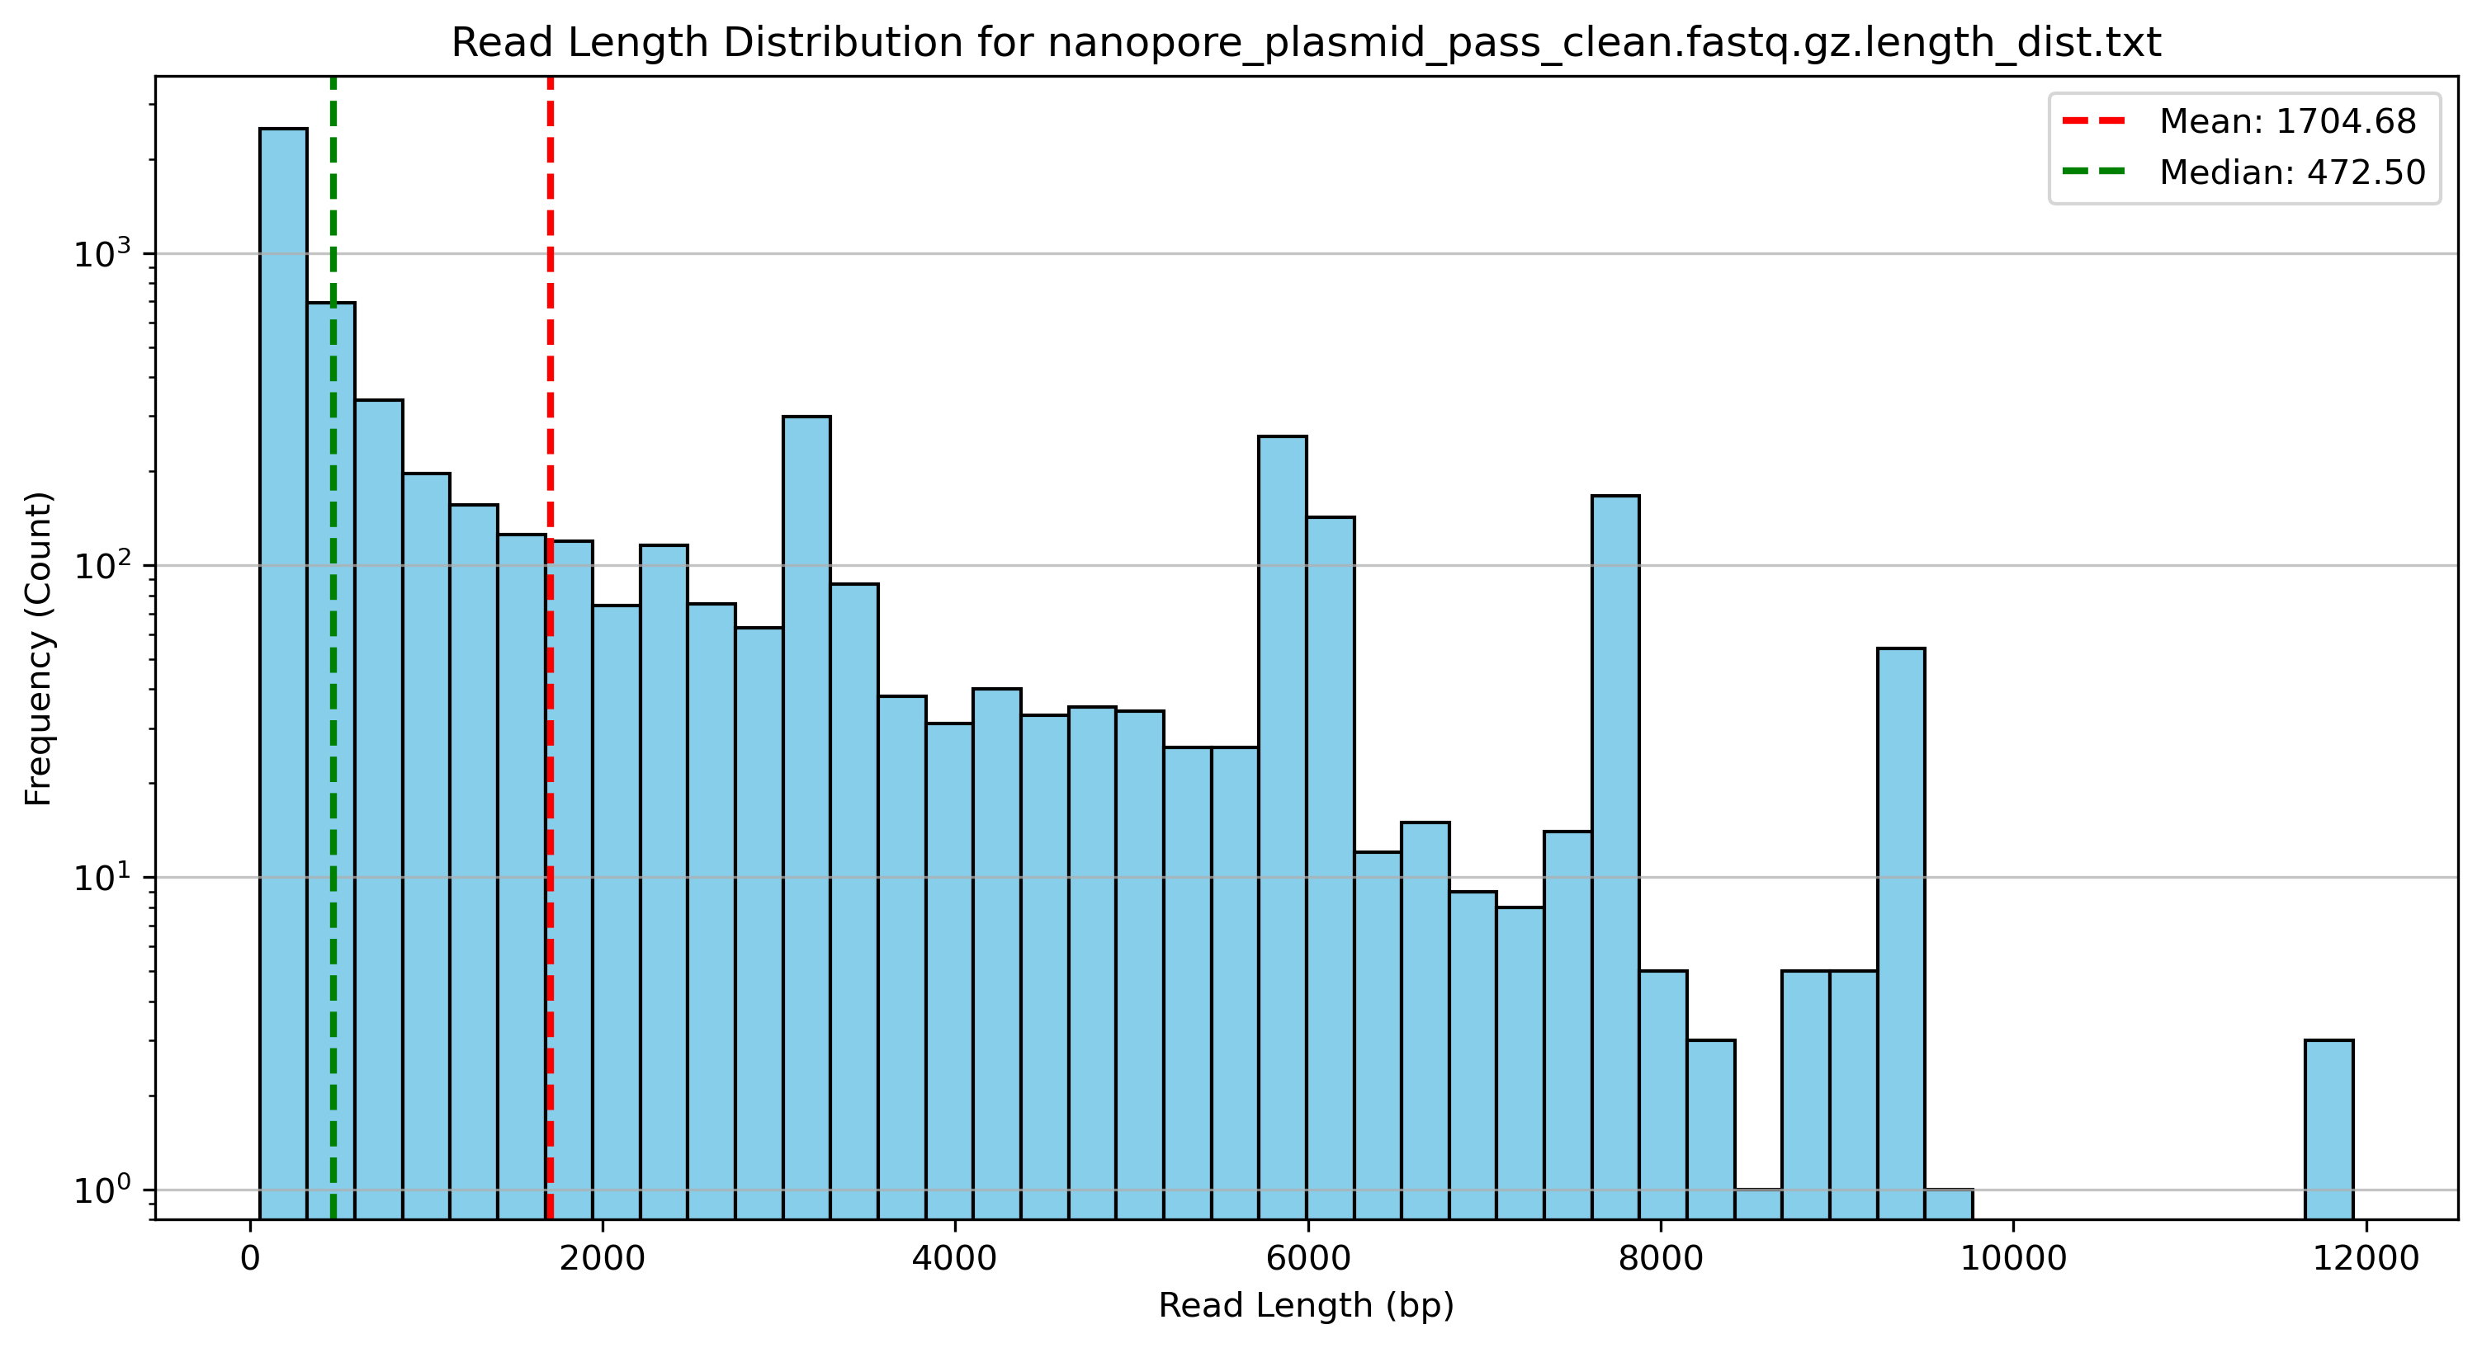

Slide 4
Methods for Nanopore Plasmid Analysis
1. quality control, filter out low quality/very short reads;
2. assembly and polish, get the consensus reads(long reads);
  based on assembly pipeline;
3. find the location of all the reads (align to the assembled contigs, in current data, there are 5 plasmids)
  every clean read try to map the best hit(assembled contig/plasmid)
  based on

